Slide 1
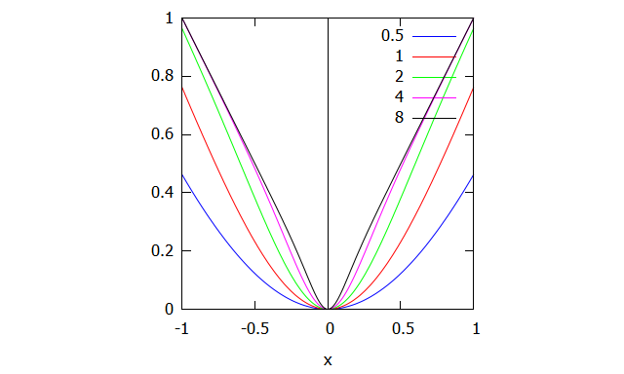
Loss Function
Loss function , also referred to as the error function , predict the difference between predict output of model and actual value. The resulting value ,loss helps mode to minimize parameters in backward propagation

Slide 2
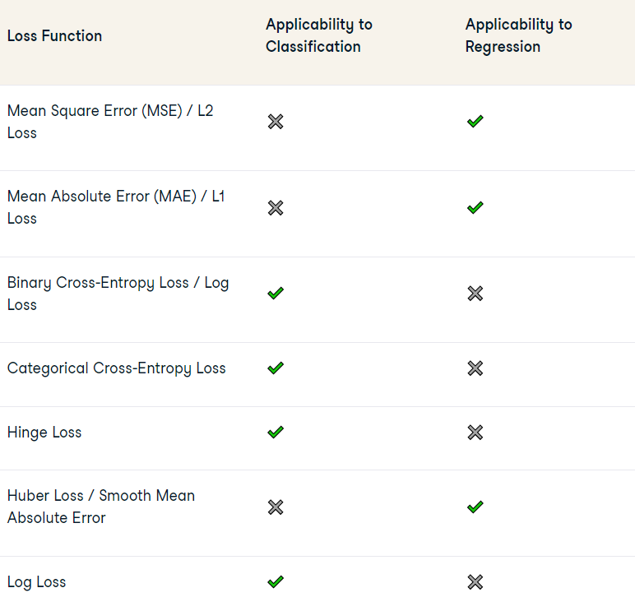
Types of loss functions
Regression Loss Functions:
Regression Loss functions are used to predict continuous output data.
Classification Loss Functions:
Classification loss functions are used when the goal is to assign an input to one of several predefined categories.

Slide 3
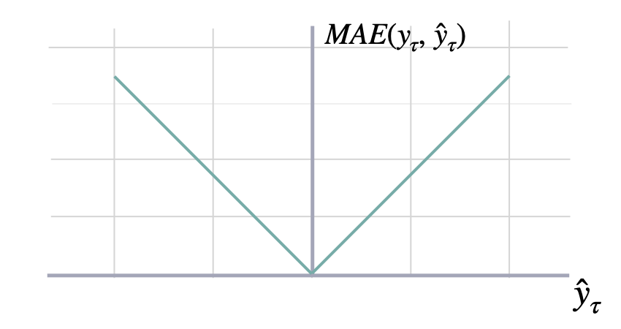
Regression Loss Function
Mean Absolute Error (MAE):
Mean Absolute error calculates average absolutes differences of predict and actual value . It is less sensitive outliers and treating all error with same weight regardless their magnitude
MAE = (1/n) * Σ|yᵢ - ȳ|

Slide 4
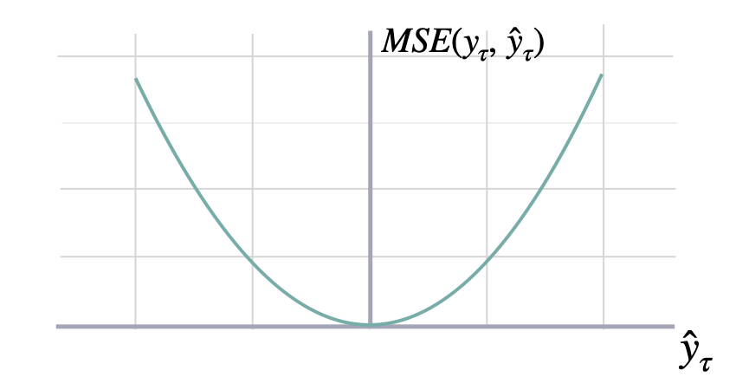
Regression Loss Function
Mean Square Error (MAE):
Mean Square error calculates average squared of differences of predict and actual value . MSE is recommended where it is conducive to the learning process to penalize significantly the presence of outliers.
MSE = (1/n) * Σ(yᵢ - ȳ)²

Slide 5
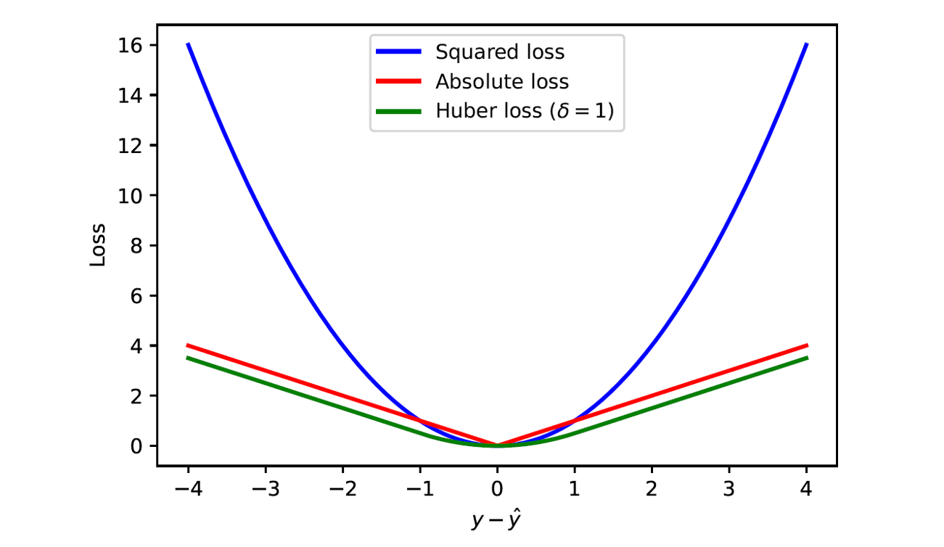
Regression Loss Function
Huber Loss\Smooth MAE:
Huber loss takes advantages of MAE and MSE . Its hybrid nature makes it less sensitive to outliers just like MAE but also penalize minor error in data set like MSE
L(δ, y, f(x)) = (1/2) * (f(x) - y)^2 if |f(x) - y| <= δ
= δ * |f(x) - y| - (1/2) * δ^2 if |f(x) - y| > δ

Slide 6
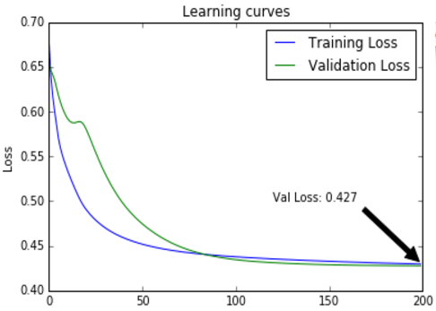
Classification Loss Functions
Binary Cross-Entropy Loss / Log Loss:
Binary Cross-Entropy Loss(BCE) is a performance measure for classification models that outputs a prediction with a probability value typically between 0 and 1, and this prediction value corresponds to the likelihood of a data sample belonging to a class or category
L(y, f(x)) = -[y * log(f(x)) + (1 - y) * log(1 - f(x))]

Slide 7
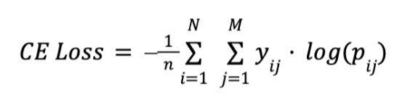
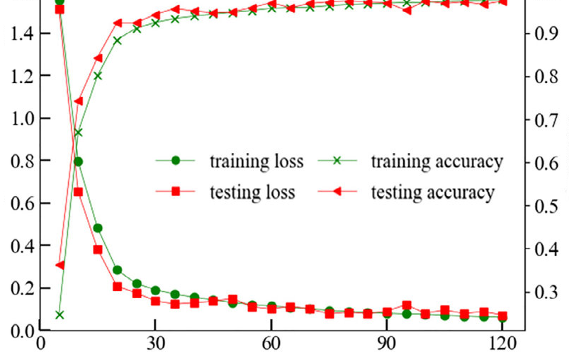
Classification Loss Functions
Categorical Cross-Entropy Loss:
In case where classes/categories are greater than 2 ,categorical cross-entropy used .

Slide 8
Key Considerations in Selecting a Loss Function
Type of Learning Problem
Model Sensitivity to Outliers
Desired Model Behavior
Computational Efficiency
Convergence Properties
The scale of the Task

Slide 10
